Slide 1
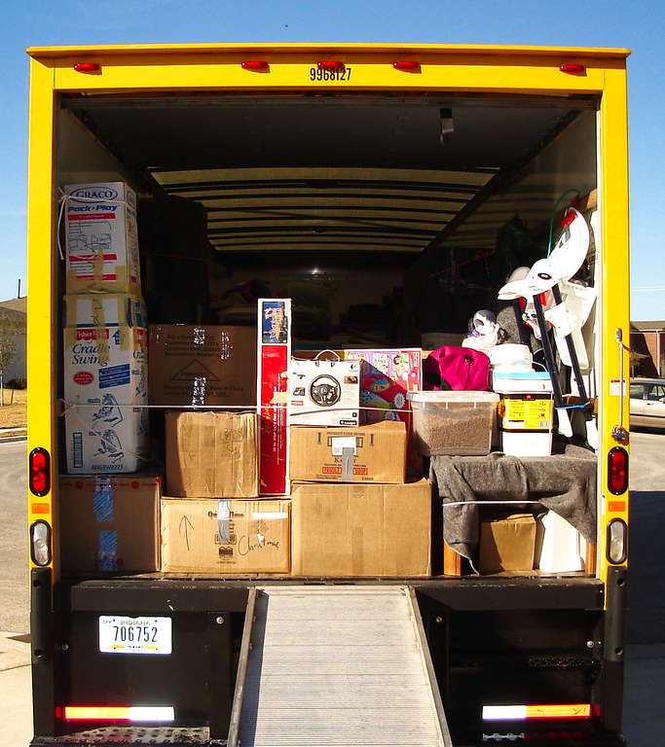
Load.in
Using AI and Computer Vision
to give your move a game plan.
Team Yellow
Design Presentation
Old Dominion University
11/8/2020
Notes:
1

Slide 2
.Contents
Feasibility:
Team Biography
The Problem
Current Process Flow
The Solution
MFCD
Will & Will not do
Market Analysis
Risk and Mitigation
Competition
Design:
Add things here
Conclusion
Misc:
Refrences
Glossary
User Stories
11/8/2020
CS 410 – Team Yellow – Load.In – Design
2
Notes:
2

Slide 3







Who is Team Yellow?
Byron Aquilino
Lance Perdue
Greg Kukanich
Jason Moran
Daniel Reyna
Chris Miller
Paul Rodriguez
11/8/2020
CS 410 – Team Yellow – Load.In – Feasibility
3
Notes:
3

Slide 4
Problem Background

Slide 5

“Do It Yourself” movers lack the expert knowledge required to handle the logistics of their move.
This Photo by theritemove.com is licensed under CC BY
11/8/2020
CS 410 – Team Yellow – Load.In – Design
5
Notes:
5

Slide 6
Do it Yourself Moving
Professional movers reduces the time but increases cost
DIY reduces the cost but decreases efficiency
This is where Load.in Comes in
11/8/2020
CS 410 – Team Yellow – Load.In – Design
6
Notes:
6

Slide 7
Professional Movers Are Costly
11/8/2020
CS 410 – Team Yellow – Load.In – Design
7
Notes:
7

Slide 8
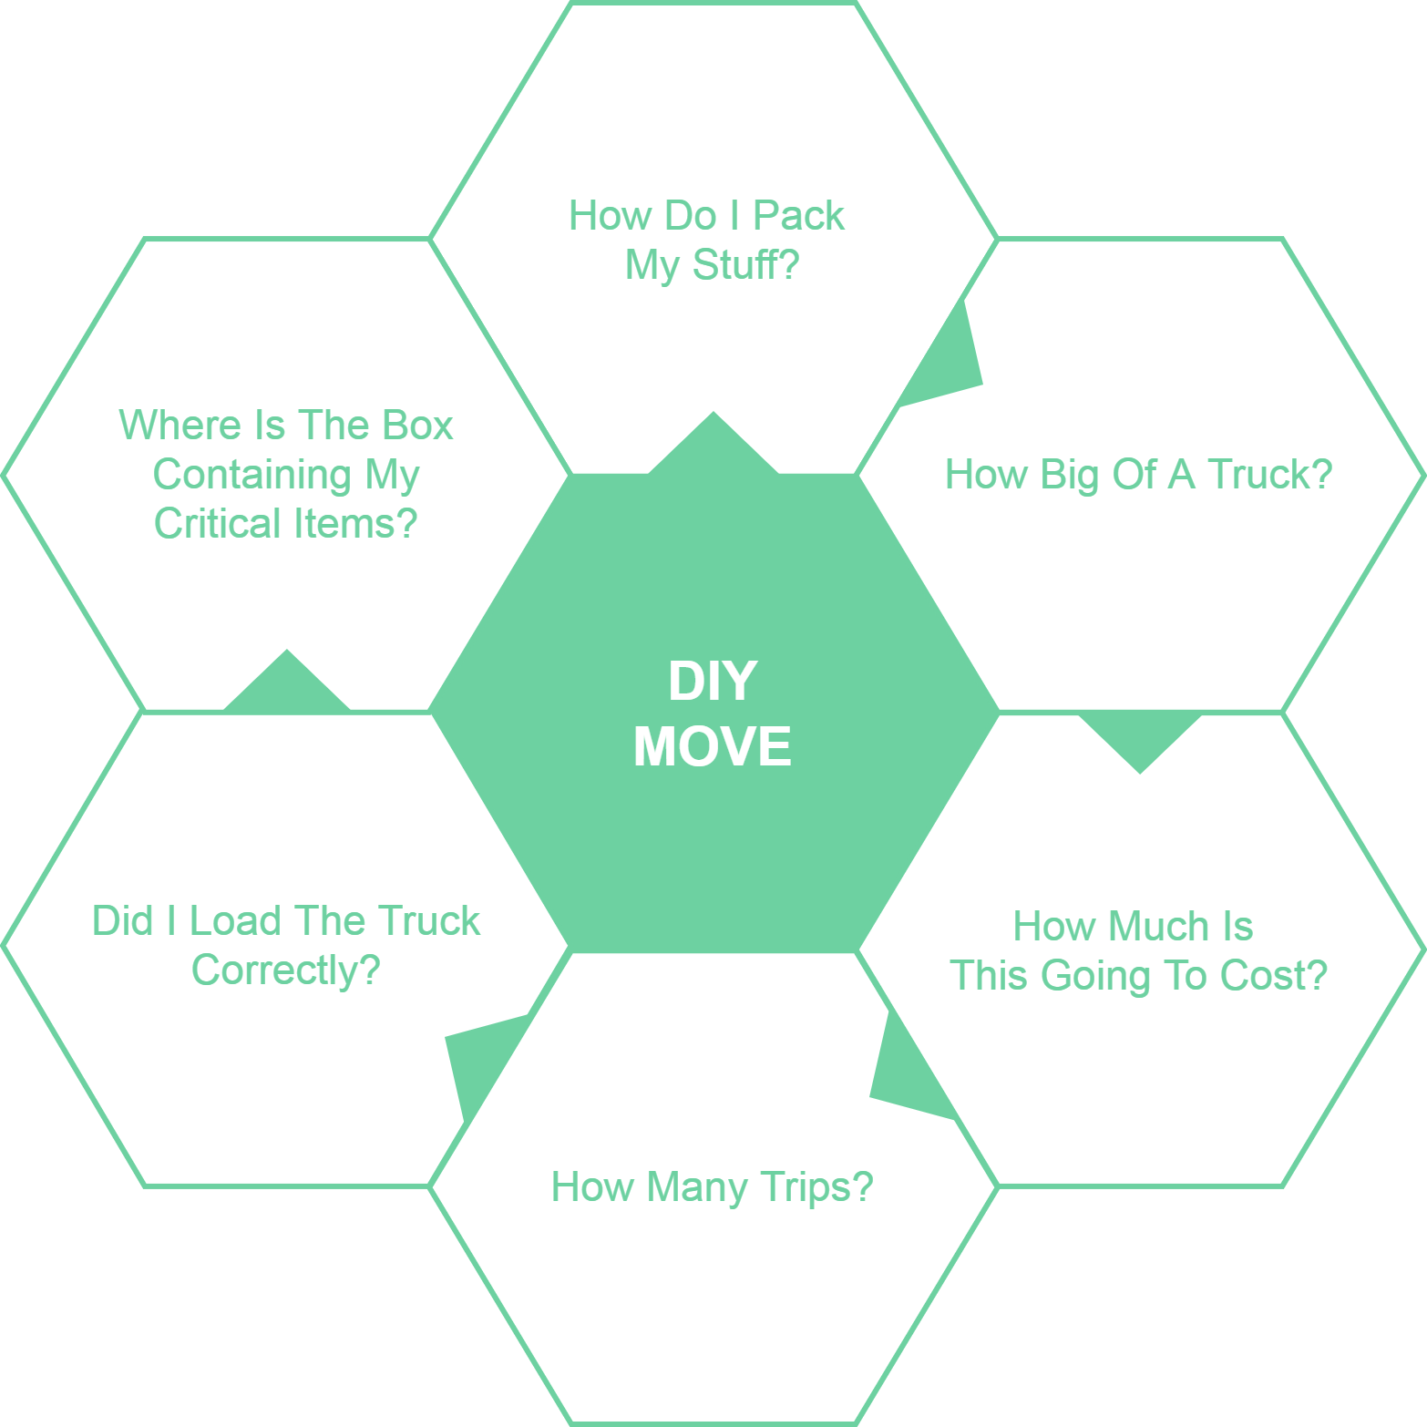
11/8/2020
CS 410 – Team Yellow – Load.In – Design
8
Notes:
8

Slide 9
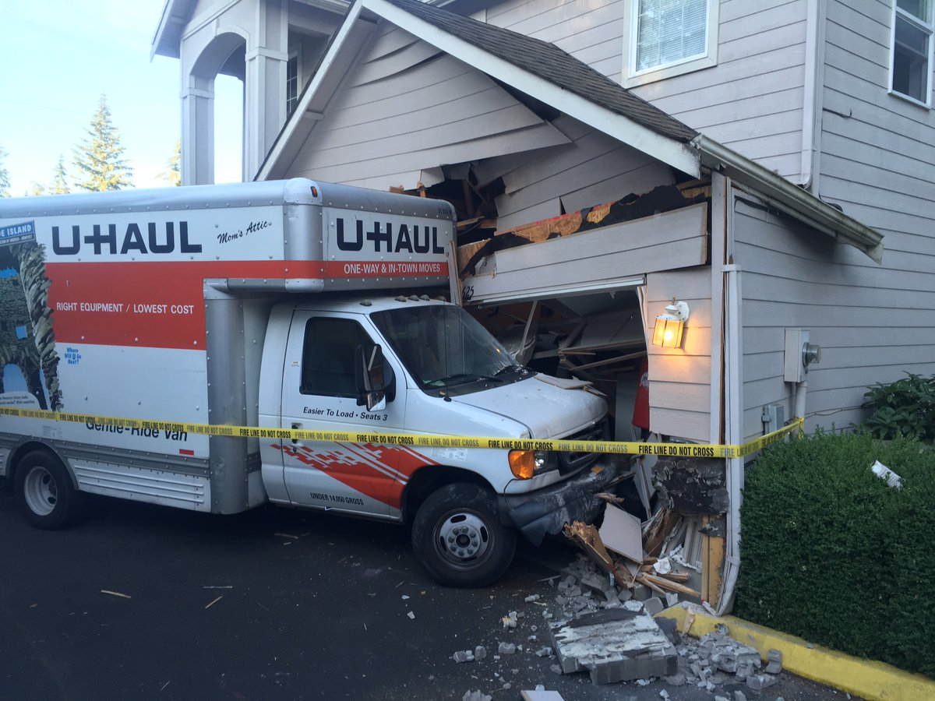
Loading can be a major issue
Poor loading can cause
Property damage
Car accidents
An estimated 50,000 accidents related to trailer towing occur each year.
This Photo by seattletimes.com is licensed under CC BY
Hayesbc.com
11/8/2020
CS 410 – Team Yellow – Load.In – Design
9
Notes:
9

Slide 10
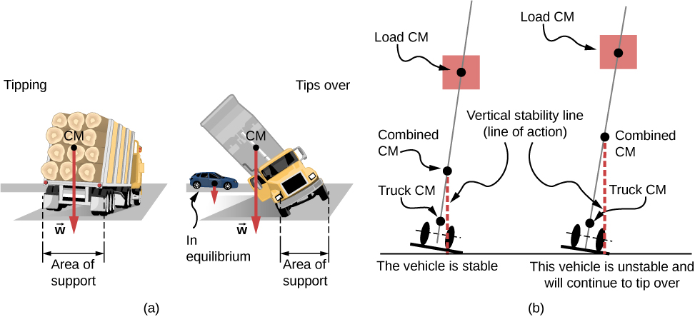

Major Truck Loading Considerations
Weight distribution
Protecting fragile items
This Photo by courses.lumenlearning.com is licensed under CC BY
This Photo by packlane.com is licensed under CC BY
PenskeTruckRental.com
11/8/2020
CS 410 – Team Yellow – Load.In – Design
10
Notes:
10

Slide 11
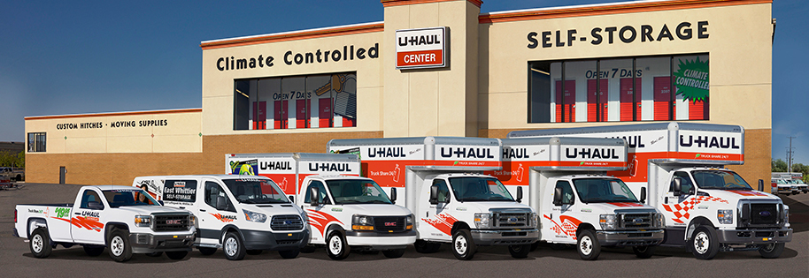
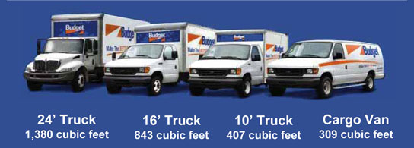
Figuring out what to rent is hard!
Accurately determining
How big of a truck to get
How many trips a move will take …is difficult.
Rental Truck companies base their business model on this!
This Photo by uhaul.com is licensed under CC BY
This Photo by truckbodyeast.com is licensed under CC BY
wtkr.com
11/8/2020
CS 410 – Team Yellow – Load.In – Design
11
Notes:
11

Slide 12
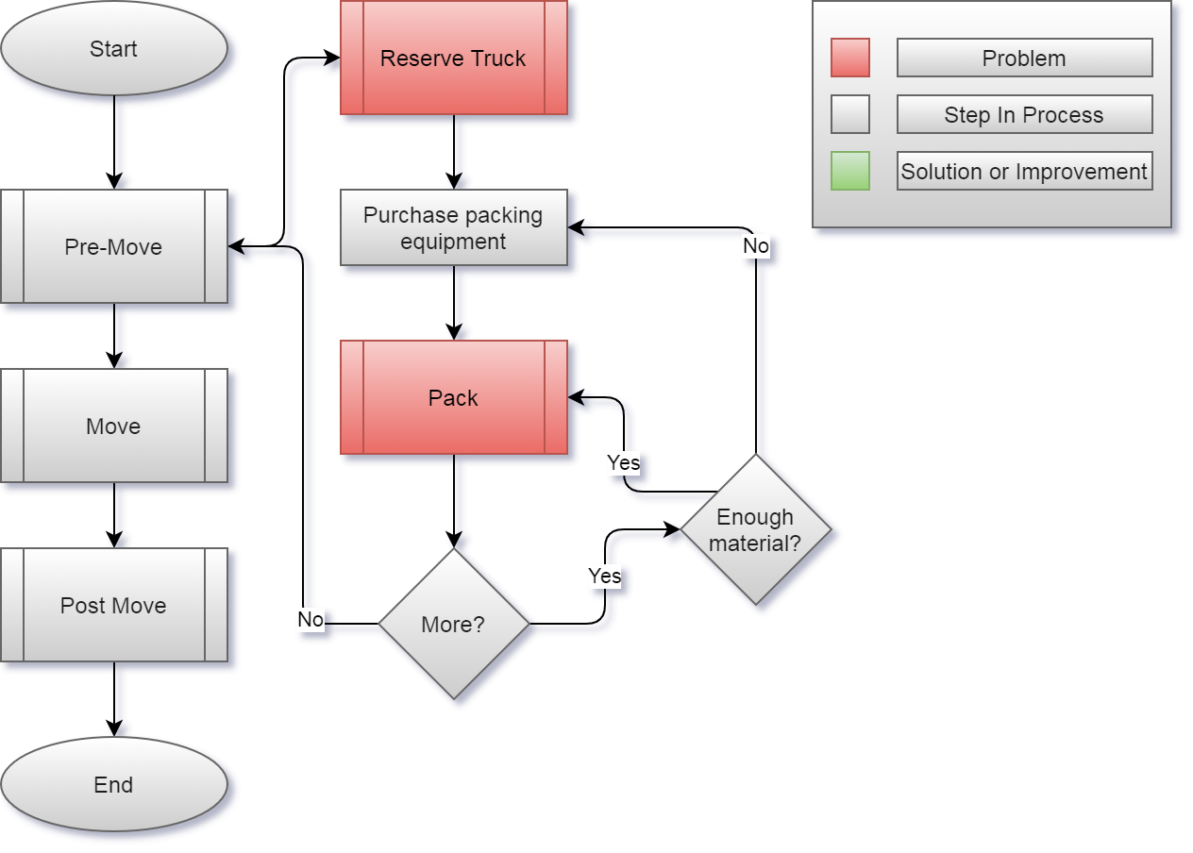
Current Process
11/8/2020
CS 410 – Team Yellow – Load.In – Design
12
Notes:
12

Slide 13
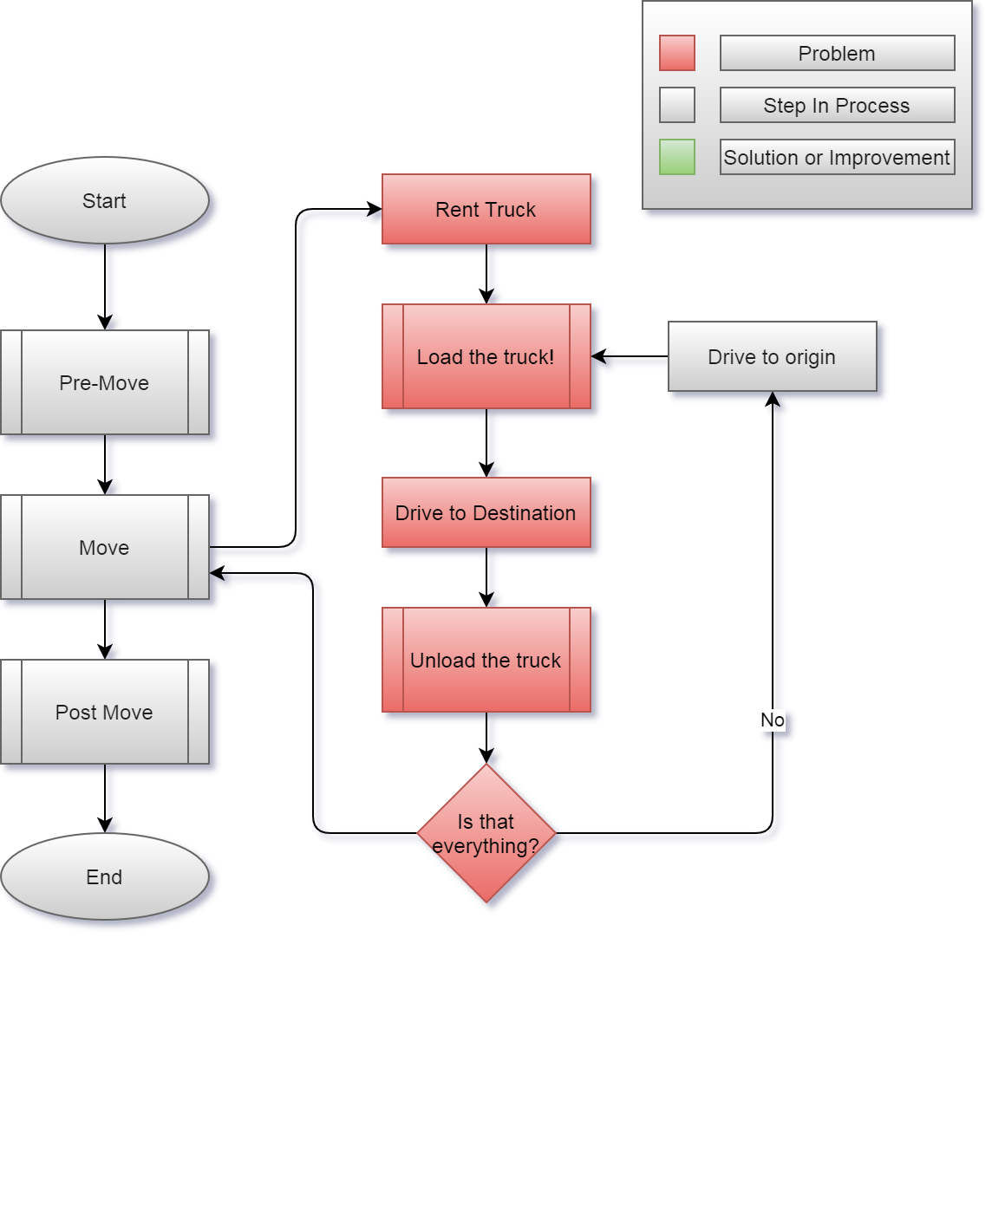
11/8/2020
CS 410 – Team Yellow – Load.In – Design
13
Notes:
13

Slide 14
Solution Description

Slide 15

Load.In gives your move a game plan
Uses artificial intelligence and computer vision
Provides
Expert-level instructions
Tips and tricks on moving day
This Photo by realtor.com is licensed under CC BY
11/8/2020
CS 410 – Team Yellow – Load.In – Design
15
Notes:
15

Slide 16
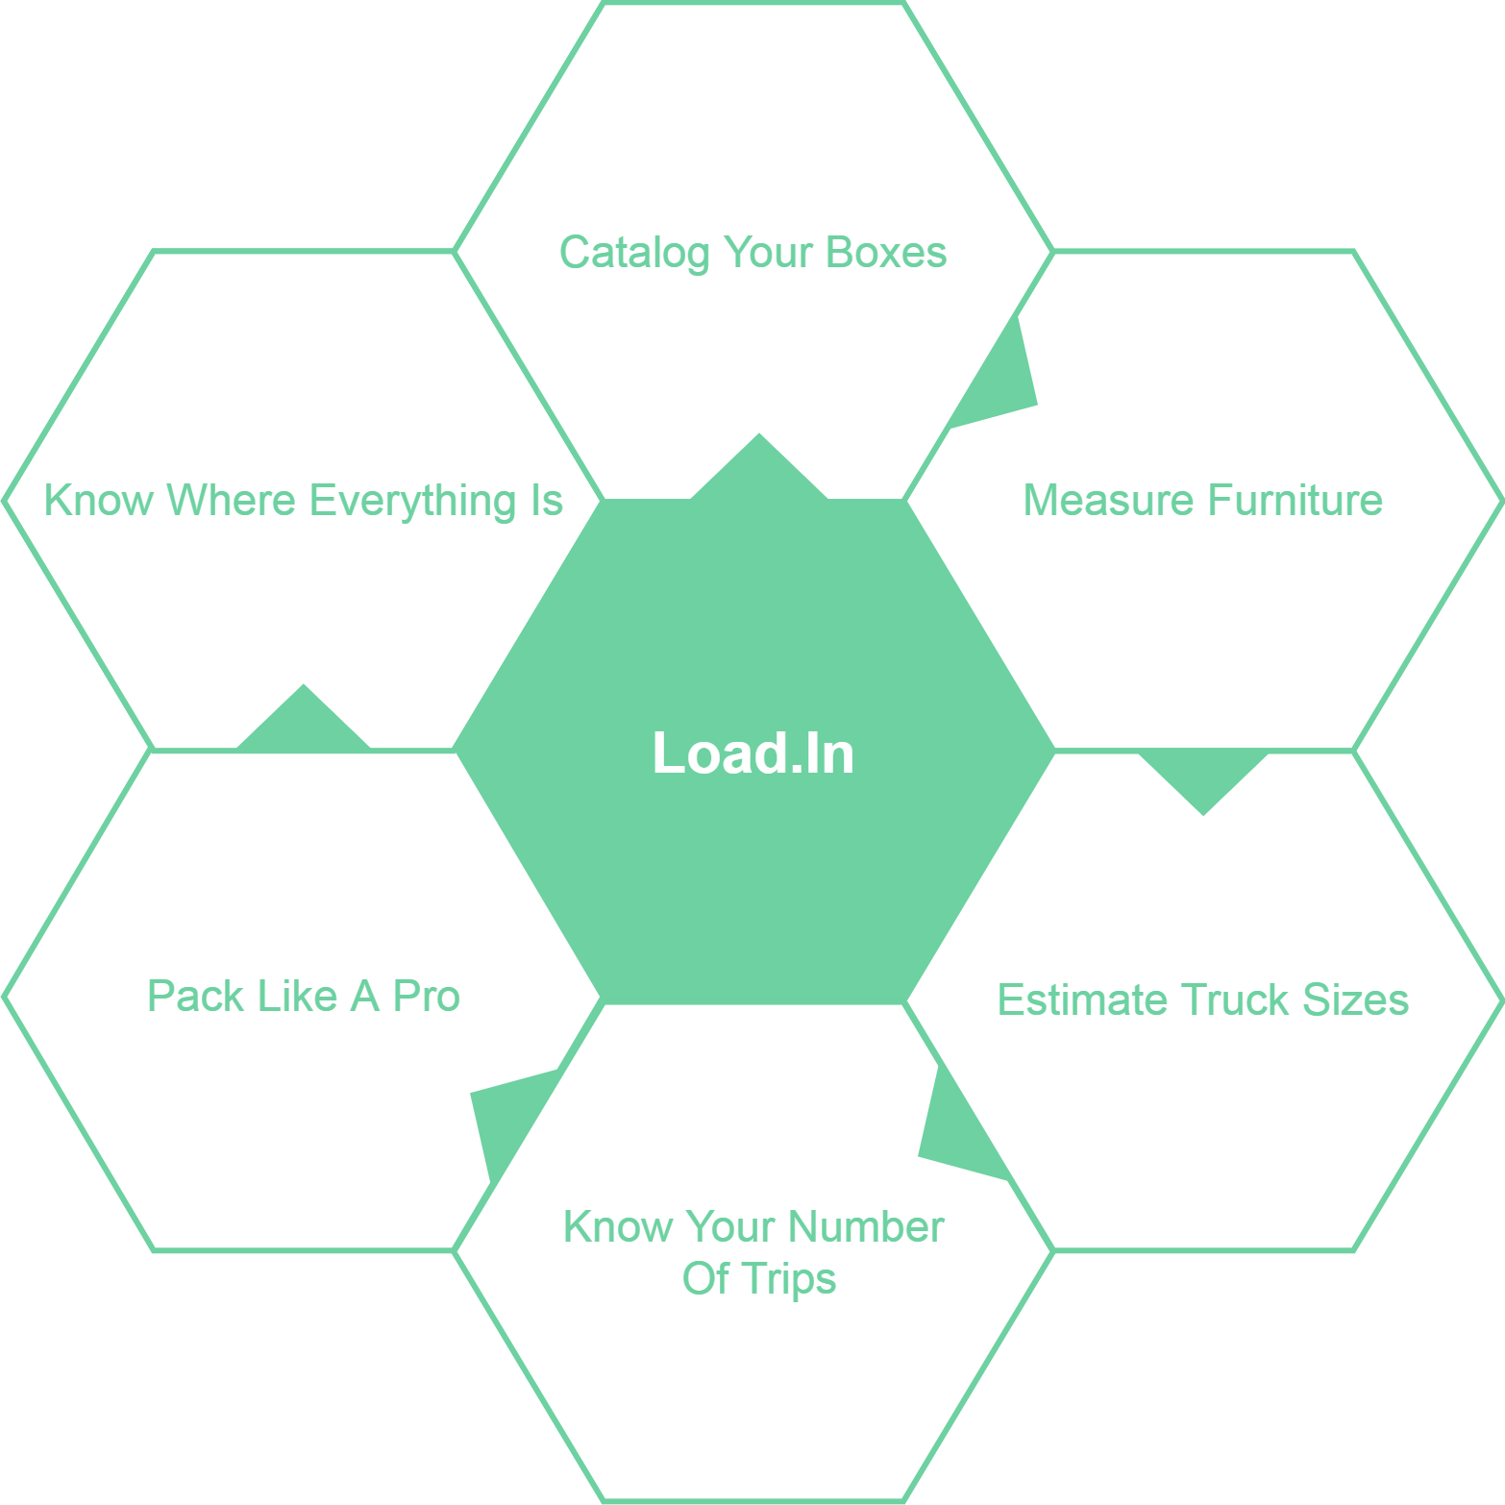
What Can Load.In Do
For You?
11/8/2020
CS 410 – Team Yellow – Load.In – Design
16
Notes:
16

Slide 17
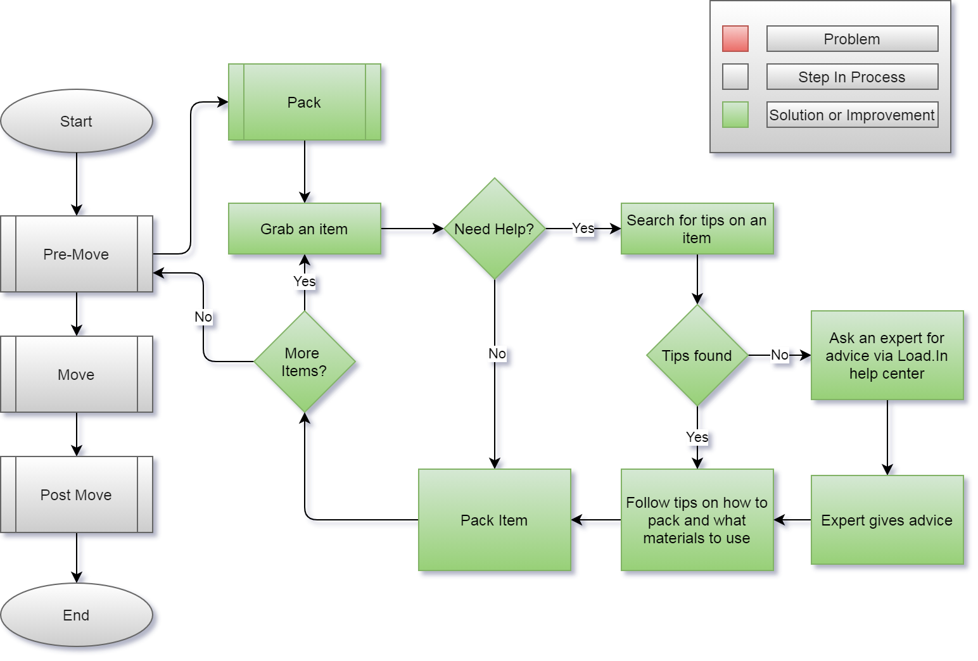
How will the solution help?
11/8/2020
CS 410 – Team Yellow – Load.In – Design
17
Notes:
17

Slide 18
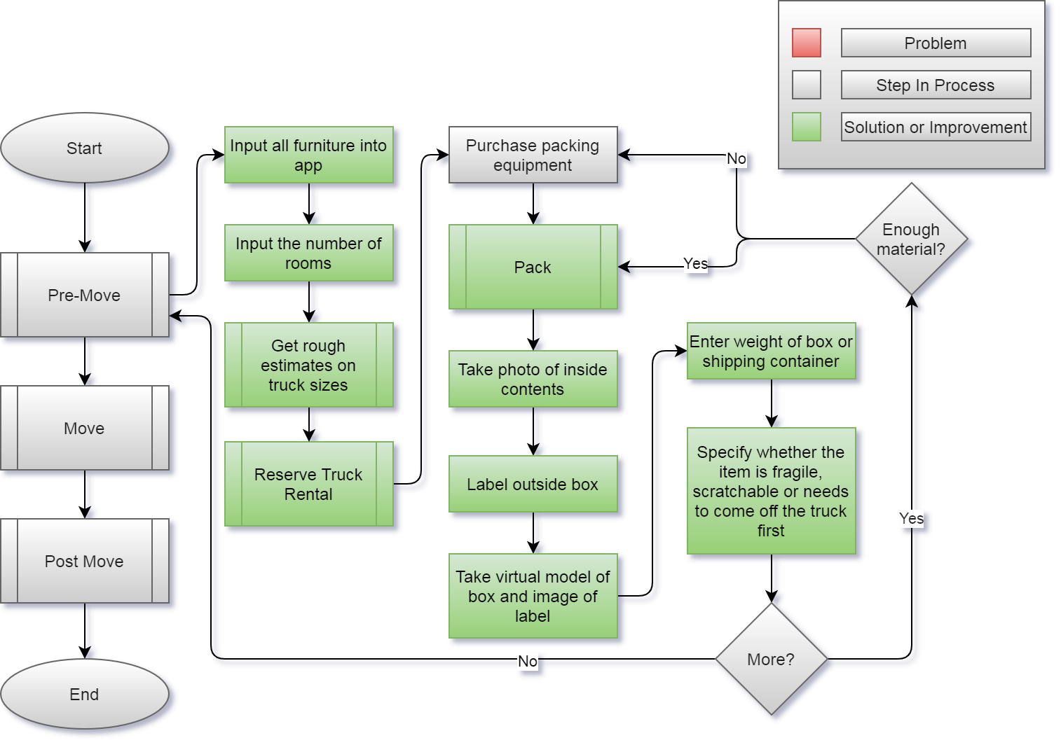
11/8/2020
CS 410 – Team Yellow – Load.In – Design
18
Notes:
18

Slide 19
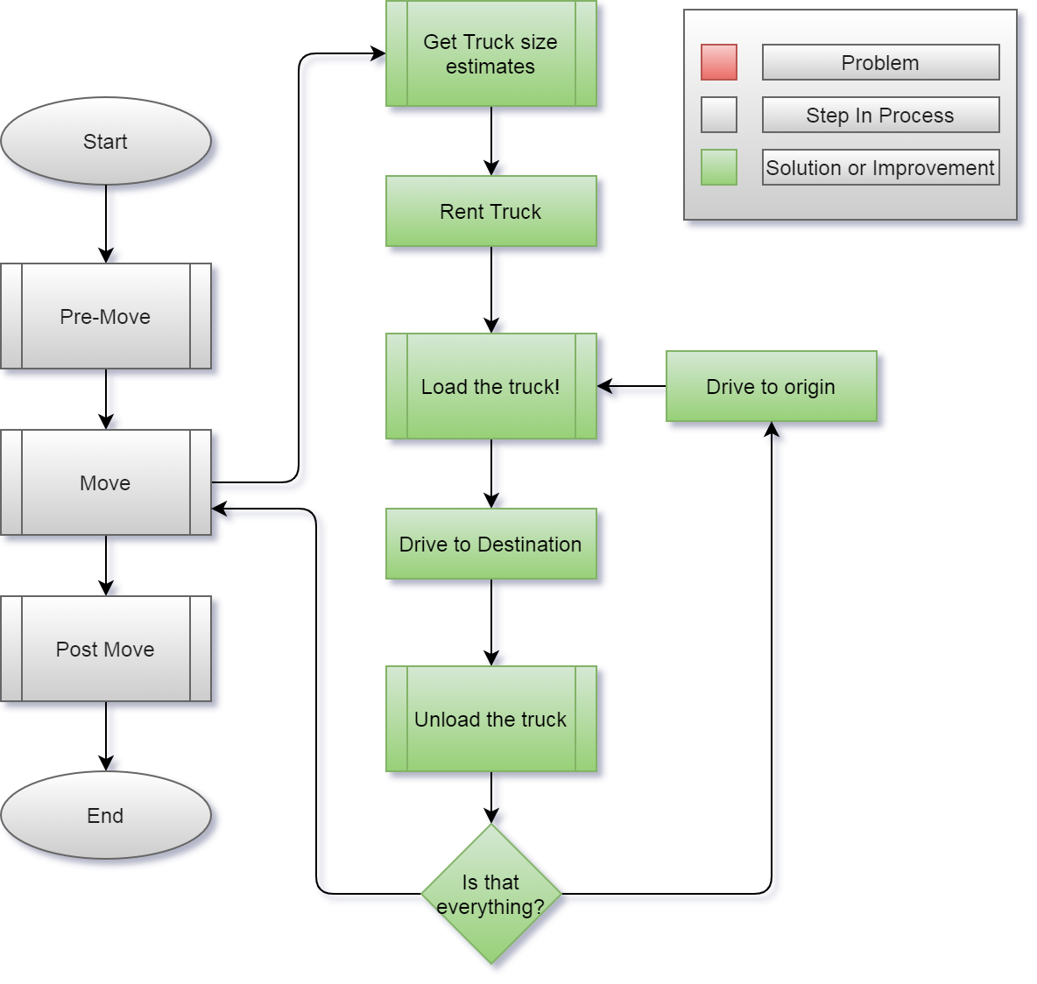
11/8/2020
CS 410 – Team Yellow – Load.In – Design
19
Notes:
19

Slide 20
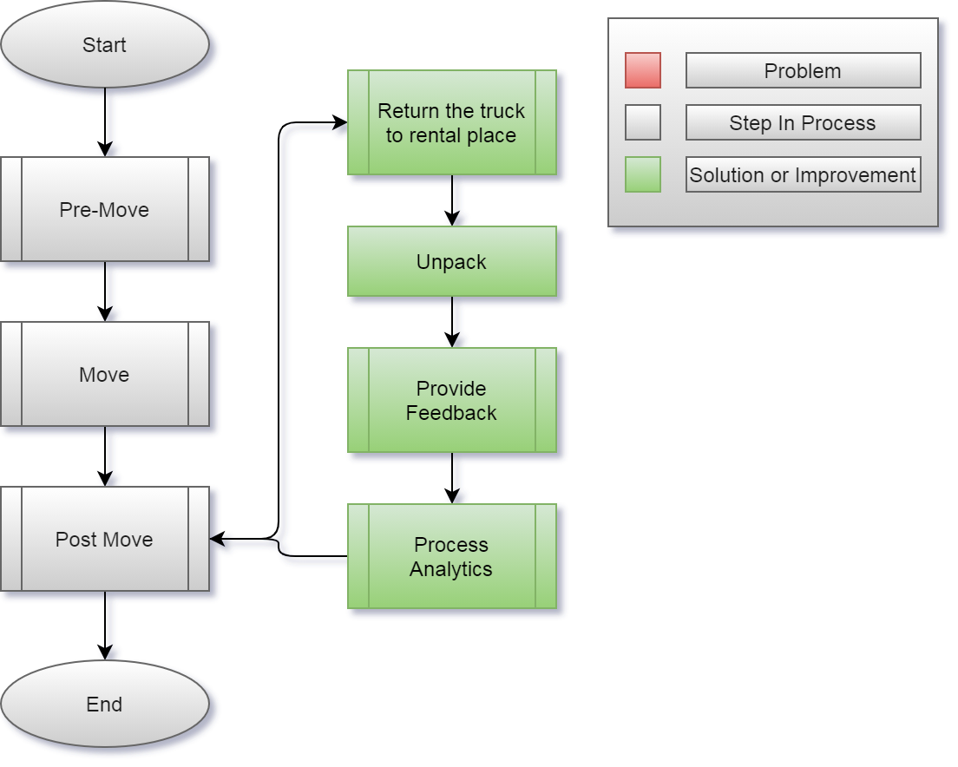
11/8/2020
CS 410 – Team Yellow – Load.In – Design
20
Notes:
20

Slide 21











Feedback Loop
Input
4
3
Training data
6
5
2
1
Pro loading strategy
Neural Network
App generates 3D models of objects to move
Output
Incorporate Feedback in to training data generation
Experience
Instructions
User gives feedback
User follows plan
Loading Plan
11/8/2020
CS 410 – Team Yellow – Load.In – Design
21
Notes:
21

Slide 22
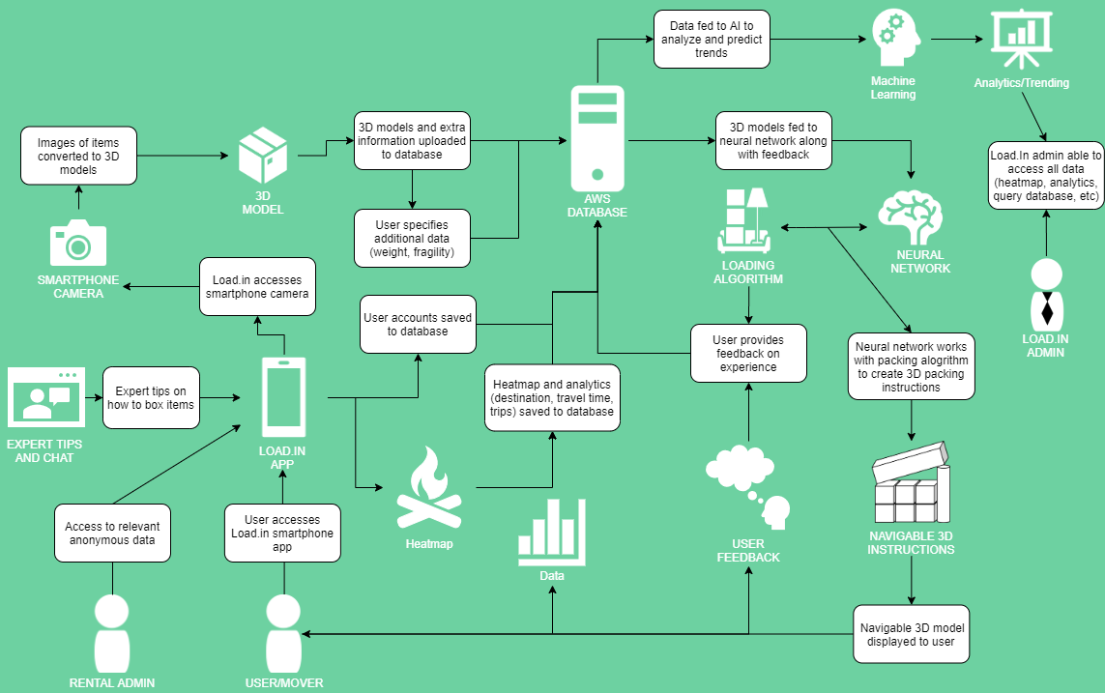
Major Functional Components
11/8/2020
CS 410 – Team Yellow – Load.In – Design
22
Notes:
22

Slide 23
What Load.In Will Do
Assist in the packing process with expert advice
Catalog with photos all boxes, furniture, and other items that are going to be placed in the truck
Generate instructions for properly loading the truck based on weight distribution, item safety, best fit space utilization, and item(s) priority
Use photos taken to Create a 3D model of how everything should be expertly packed in the truck
Will provide location information for different boxes and items within the truck using 3D model and cataloging
Give estimate for appropriate rental truck size and number of trips dependent on truck size
11/8/2020
CS 410 – Team Yellow – Load.In – Design
23
Notes:
23

Slide 24
What Load.In Won’t Do
Pack boxes
Load or unload truck
Assist in the driving process
11/8/2020
CS 410 – Team Yellow – Load.In – Design
24
Notes:
24

Slide 25
Design Approach

Slide 26
.Sprint Breakdown
Sprint 1
Sprint 2
Sprint 3
Sprint 4
Core feedback loop
Deployment Infrastructure
Framework for major components
Initial implementation of Photogrammetry
Initial implementation of help features
Improved Photogrammetry
Initial Implementation of Packing Algorithm
Improved Packing Algorithm
Improved Photogrammetry
CS 410 – Team Yellow – Load.In – Design
26

Slide 27
Risk & Mitigation

Slide 28
Technical Risks
Probability
 |  | Very Low | Low | Medium | High | Very High
Severity | Very High |  |  |  |  | T-1
 | High |  |  |  | T-2
 | Medium |  |  | T-3
 | Low
 | Very Low
T-1: Current technology involving computer vision is a challenge.
T-1 Mitigation: Conduct a prototype to mitigate risk of critical errors upon release.
T-2: Artificial Intelligence prone to error due to insufficient training data.
T-2 Mitigation: Implementing a feedback loopback in the beta phase with test users.
T-3: Challenge to obtain accurate and timely feedback.
T-3 Mitigation: Implement a feature for users to give feedback if the application operated correctly after completing a move.
11/8/2020
CS 410 – Team Yellow – Load.In – Design
28
Notes:
28

Slide 29
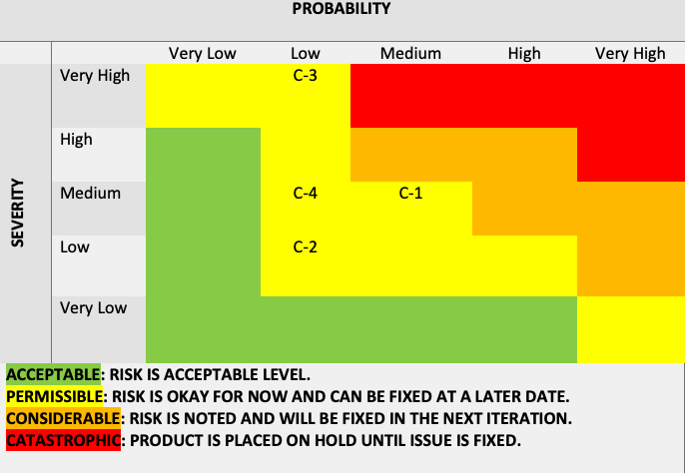
Customer Risks
C-1: End user is inexperienced with the application.
C-1 Mitigation: Implement a tutorial on how to use the application and provide a help feature.
C-2: End user finds UI challenging to operate.
C-2: Mitigation: Implement analytics for tracking when a user stop using the application.
C-3: End users are not satisfied with the recommendations of the application.
C-3 Mitigation: Implement a customer feedback feature that allows the users to disclose his/her issues with the applications.
C-4: End user doesn’t follow the guidelines of the application.
C-4 Mitigation: Implement a feature that allows the user to repeat/reset certain steps in the application as they progress.
Probability
 |  | Very Low | Low | Medium | High | Very High
Severity | Very High
 | High |  | C-1
 | Medium |  | C-2 | C-3
 | Low |  |  |  | C-4
 | Very Low
11/8/2020
CS 410 – Team Yellow – Load.In – Design
29
Notes:
29

Slide 30
Security Risks
Probability
 |  | Very Low | Low | Medium | High | Very High
Severity | Very High
 | High
 | Medium
 | Low |  | S-1,S-2
 | Very Low
Risk: End user want to ensure the pictures taken of personal information doesn’t fall into the wrong hands.
Mitigation: During the feedback stage after a move, have the end user have the ability to delete personal information collected during the move.
Risk: End user wants to ensure his/her data isn’t being collected for nefarious purposes.
Mitigation: Allow the end user to opt out of the analytics program inside of the user settings and disclose what his/her data is being used for.
11/8/2020
CS 410 – Team Yellow – Load.In – Design
30
Notes:
30

Slide 31
Conclusion
DIY Movers are faced with many logistical difficulties
Properly loading truck
Protecting valuables
Finding the best deal
Keeping track of every box
All during an already stressful life event!
Load.In will provide customized expert instructions
Truck loading instructions based on photogrammetry
Cost minimization based on input data
Map of truck available to assist in finding boxes
Provide unique insights to moves due to captured analytics
11/8/2020
CS 410 – Team Yellow – Load.In – Design
31
Notes:
31

Slide 32
32
Notes:
32

Slide 33
Sources:
The Top 5 Moving Mistakes Across America. (2019, August 13). Article. https://www.article.com/blog/top-5-moving-mistakes/
Economy Moving & Storage, LLC. (2015, January 4). How to properly pack and load a moving truck- Movers Cincinnati. YouTube. https://www.youtube.com/watch?v=rjmofUZOdwo&feature=youtu.be
CADCode Systems. (n.d.). Optimizing & Machining | CADCode Systems. CADCode.Com. Retrieved September 20, 2020, from https://www.cadcode.com/category/categories/optimizing-machining
Dube, E. (2020, September 20). OPTIMIZING THREE-DIMENSIONAL BIN PACKING THROUGH SIMULATION. Semantics Scholar. https://www.semanticscholar.org/paper/OPTIMIZING-THREE-DIMENSIONAL-BIN-PACKING-THROUGH-Dube/bb9986af2f26f7726fcef1bc684eac8239c9b853#references
Knoblauch, M. (2019, May 8). One in ten Americans would prefer a week in jail over moving. New York Post. https://nypost.com/2019/05/08/one-in-ten-americans-would-prefer-a-week-in-jail-over-moving/
The American Institute of Stress. (n.d.). The Holmes-Rahe Stress Inventory PDF. Retrieved September 20, 2020, from https://www.stress.org/wp-content/uploads/2019/04/stress-inventory-1.pdf
Wood, T. (2020, January 6). Moving Industry Statistics. MoveBuddha. https://www.movebuddha.com/blog/moving-industry-statistics/
Nat and Friends. (2017, April 18). Google Earth’s Incredible 3D Imagery, Explained. YouTube. https://www.youtube.com/watch?v=suo_aUTUpps&feature=youtu.be
Collins, T. (2018, April 20). A Look Into Photogrammetry and Video Games - Tiger Collins. Medium. https://medium.com/@homicidalnacho/a-look-into-photogrammetry-and-video-games-71d602f51c31
11/8/2020
CS 410 – Team Yellow – Load.In – Feasibility
33
Notes:
33

Slide 34
Glossary:
*All definitions are sourced from Wikipedia
Photogrammetry
Photogrammetry is the science and technology of obtaining reliable information about physical objects and the environment through the process of recording, measuring and interpreting photographic images and patterns of electromagnetic radiant imagery and other phenomena.
Algorithm
A finite sequence of well-defined, computer-implementable instructions, typically to solve a class of problems or to perform a computation.
Professional movers
Professionals who move all your belongings for you from one place to another.
Packing problems
Are a class of optimization problems in mathematics that involve attempting to pack objects together into containers. The goal is to either pack a single container as densely as possible or pack all objects using as few containers as possible.
11/8/2020
CS 410 – Team Yellow – Load.In – Feasibility
34
Notes:
34

Slide 35
Target Consumers and End Users
Customers
Do it yourself movers
Rental Companies
CS 410 – Team Yellow – Load.In – Design

Slide 36
Benefits to Customer
Being shown how to
Pack boxes for increased organization
Properly load their truck for increased efficiency
Being provided with expert advice
Database full of tips that a user can search through with keywords
Live-chat support for questions not answered through the tips
Saving of Time and Money
Increased efficiency will lead to less trips and materials used
Peace of Mind
Fragile items being safely transported
CS 410 – Team Yellow – Load.In – Design

Slide 37
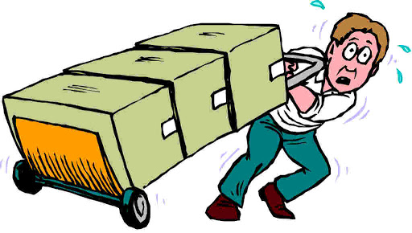


User Roles
Mover
Move Expert
Rental Company Representative
Individual who is moving between two locations
Individual who is very knowledgeable in the moving industry
How to describe this ?
CS 410 – Team Yellow – Load.In – Design

Slide 38
Slides from the feasibility presentation not called out by name in the design rubric but why delete them?

Slide 39

The Moving Industry Market
Nearly all moving companies are either all inclusive or DIY
However the all-inclusive services are often very expensive
All the DIY services provide no assistance or guidance and lead to confusion and wasted money
The market is shifting towards software being utilized to increase efficiency and decrease costs
This Photo by technavio.com is licensed under CC BY
11/8/2020
CS 410 – Team Yellow – Load.In – Feasibility
39
Notes:
39

Slide 40
Benefits to the Customer
Being shown how to
Pack boxes for increased organization.
Properly load their truck for increased efficiency.
Being provided with a database of useful tips from professional movers.
Saving of money and time due to the entire moving process being made more efficient.
Peace of mind about fragile items safely transported
11/8/2020
CS 410 – Team Yellow – Load.In – Feasibility
40
Notes:
40

Slide 41
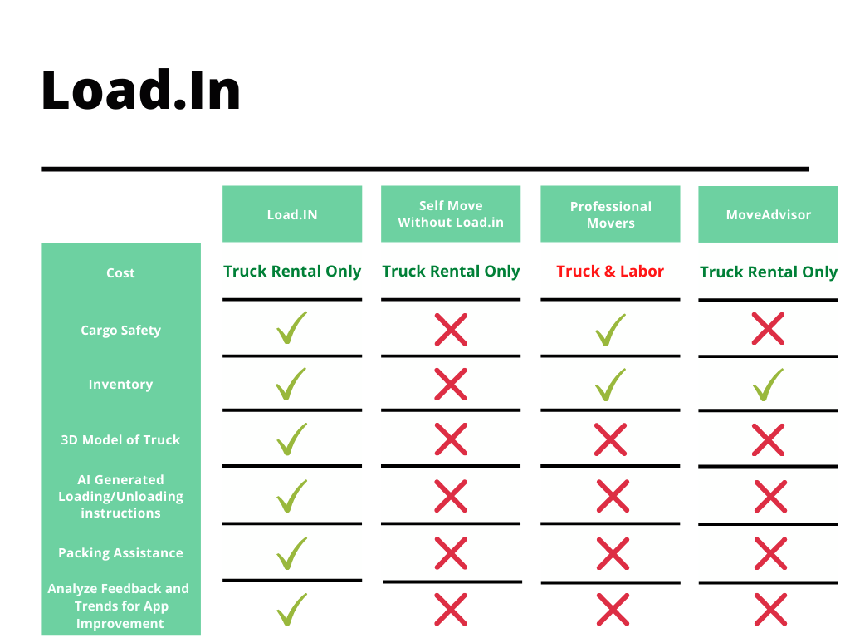
The Competition
11/8/2020
CS 410 – Team Yellow – Load.In – Feasibility
41
Notes:
41

